Slide 1
LAWYER BOT: AN AI-POWERED VIRTUAL ASSISTANT FOR ACCESSIBLE LEGAL
GUIDANCE AND PROMOTION OF LEGAL LITERACY IN INDIA
SUBMITTED BY:
ANITHA . V - 821220104001
BHARANI MATHAN . M - 821220104004
SELVA PRAVEEN . P - 821220104023
HARI KRISHNAN . S - 821220104009
GUIDED BY:
Mrs . MENAKA . P

Slide 2
ABSTRACT
Add a Lawyer Bot is an affordable AI virtual assistant focused on providing easy access to basic legal information. Using natural language processing and BERT, it tackles minor legal issues, specifically in Indian laws. Users describe concerns, and Lawyer Bot AI offers accurate advice, promoting legal literacy while being cost-effective and user-friendly.

Slide 3


OBJECTIVES
Create a user-friendly platform to ask legal questions using simple language.
Interactive AI virtual assistant for guidance.
Make legal information easily accessible to everyone.

Slide 4


EXISTING SYSTEM
Legal consultation service:
Get legal advice without the hassle.
Manual Legal Research:
Legal research involves manually searching through legal databases, books, and documents to find relevant laws and case precedents..

Slide 5
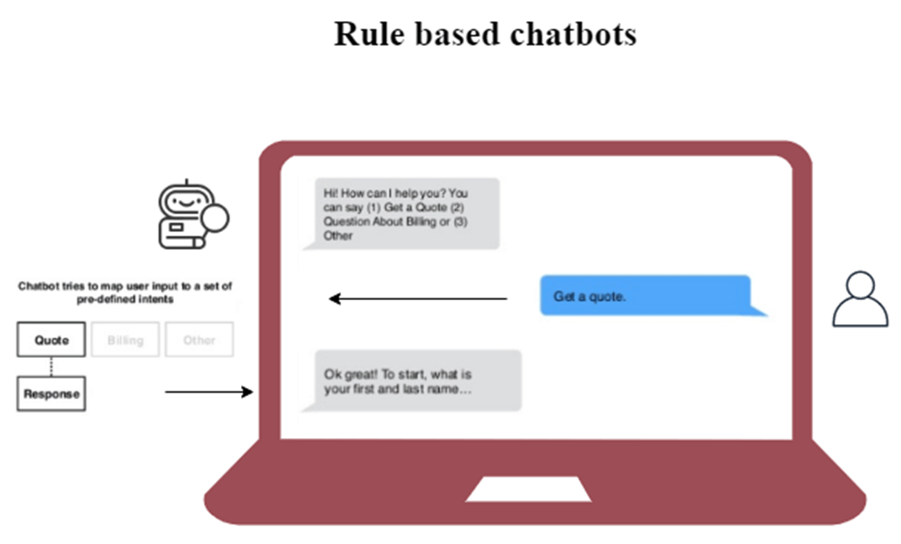
EXISTING ALGORITHM
Rule – Based or Scripted Chatbots are the simplest type because they use a decision tree to
Communicate with users

Slide 6

DRAWBACK
High costs and financial barriers.
Time-consuming processes and potential delays. Limited accessibility, especially in remote areas.
Complexity of legal language and procedures.

Slide 7
PROPOSED SYSTEM
Interactive Chatbot
Creating a chatbot to help with legal queries, using NLP tech, lets users ask about laws in a friendly conversation.
NLP
NLP, or Natural Language Processing, helps computers understand and respond to human language.
Bidirectional Encoder Representations from Transformers (BERT)
Uses BERT to better understand context, giving accurate answers to questions about Indian laws and sections.

Slide 8
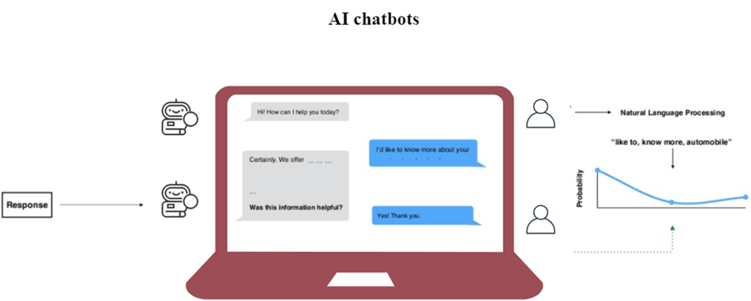
PROPOSED SYSTEM

Slide 9
MERITS
Provides a user-friendly platform accessible anytime, anywhere.
Fast and streamlined access to law details through natural language queries.
Designed to provide accurate and up-to-date information.
Easily access information about law and law firms.

Slide 10
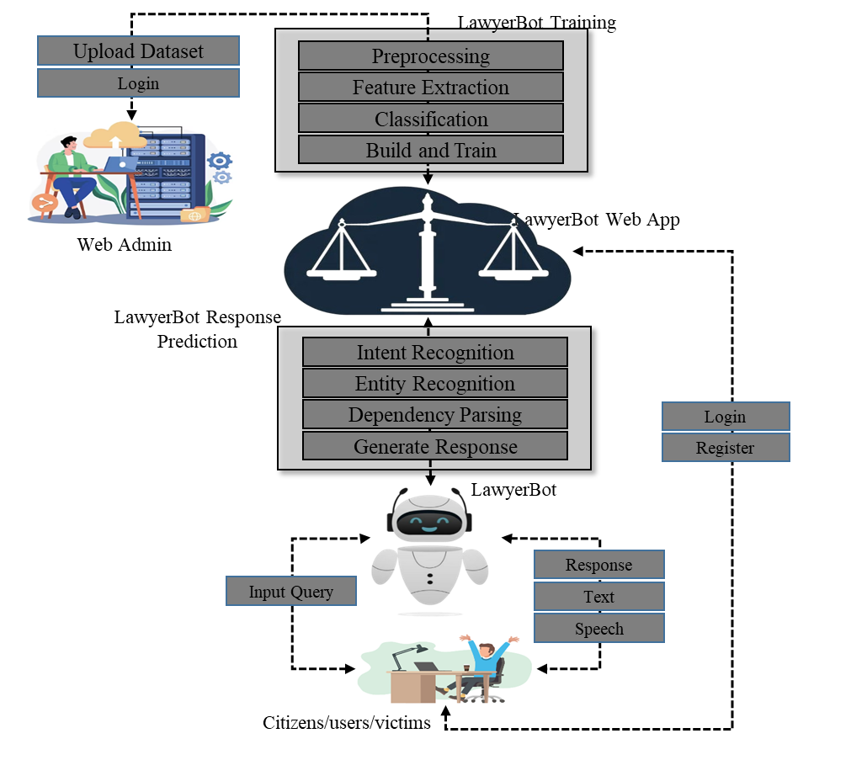
SYSTEM ARCHITECTURE

Slide 11
SYSTEM REQUIREMENTS
Hardware Requirements
Processors : Intel® Core™ i5 processor, 8 GB of DRAM
Disk space : 320 GB
Operating System : Windows10®
Software Requirements
Server Side : Python 3.7.4(64-bit) or (32-bit)
Client Side : HTML, CSS, Bootstrap IDE : Flask 1.1.1
Back end : MySQL 5.
Server : Wampserver 2i
NLP Packages

Slide 12
MODULE DESCRIPTION
Lawyer Bot Web App
Lawyer Bot – Model Training
Lawyer Bot Chat Window
End User
4.1 Citizen
4.2 Bot Trainer
5. Notification

Slide 13


MODULES DESCRIPTIONS
1. LawyerBot Web App :
The design and development of the LawyerBot web app involve integrating different technologies and tools to create a seamless user experience for users.
The front end, back end, and database work together to provide an efficient and reliable platform for users to get answers to their queries related to law.

Slide 14


2. LawyerBot Web Window :
The chat window of LawyerBot is the main interface where users can interact with the chatbot.
It is designed using HTML, CSS, and JavaScript and integrated with the backend developed using Python Flask and MySQL..

Slide 15



3. LawyerBot - Model training :
LawyerBot, being an AI-based chatbot, requires extensive training in natural language processing (NLP) techniques.
The following are the sub modules involved in training the LawyerBot chatbot.
Data Collection
Pre-processing Feature Extraction
Classification and
Training

Slide 16

4. End User :
4.1. User :
The user interface consists of modules for registering, logging in, inputting queries in English, and receiving responses from the chatbot.
The users can perform the following tasks :
Register with the chatbot by providing their name, email address, and password.
Log in to their account.

Slide 17
Input queries related to legal in English.
Receive responses from the chatbot that are generated using natural language processing techniques.
The chatbot responds in text and text-to-speech formats, making it accessible to users who are not proficient in reading and writing.

Slide 18
4.2. Citizens
The admin interface consists of modules for collecting, pre- processing, and training the chatbot with data related to Legal activities.
The admin can perform the following tasks:
Collect dataset related to legals and laws.
Train the chatbot using natural language processing techniques.

Slide 19
5. Notification
•
The "Notification" module in the LawyerBot system would handle alerting users about important legal updates, reminders, or notifications relevant to their queries or legal situations.

Slide 20
FUTURE ENHANCEMENT
Looking forward, LawyerBot can improve and grow in many ways:
Mobile Application Development:
Create a mobile app for LawyerBot so people can easily get legal help on their phones and tablets. We'll make sure it's easy to use on mobile devices.
Collaboration with Legal Professionals:
Work with legal experts to make LawyerBot better. We'll team up with law firms and professionals to get their advice and make sure the platform helps both lawyers and users.
Case Management System:
Add a system to LawyerBot to help you keep track of your legal stuff. It'll let you store documents, manage tasks, and remind you about important dates on a calendar.
Legal Document Analysis:
Make LawyerBot able to understand legal papers like contracts and court decisions. It'll summarize them, pick out important parts, and identify legal terms and entities.

Slide 21
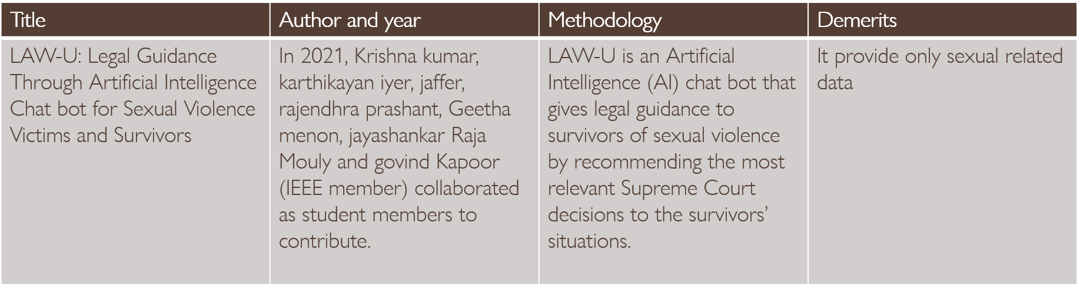
LITERATURE SURVEY

Slide 22
CONCLUSION
LawyerBot aims to make legal help easy to access by using technology like NLP and machine learning. It helps users with legal questions by providing a user-friendly platform. It can classify offenses accurately and suggest legal professionals based on your query and location. Plus, it's easy for admins to manage. Overall, LawyerBot makes legal assistance accessible to everyone.

Slide 23
THANK YOU

